Slide 1
Basic Electronics
Presented by
The MakerHive

Slide 2
What is Electricity?

Slide 3
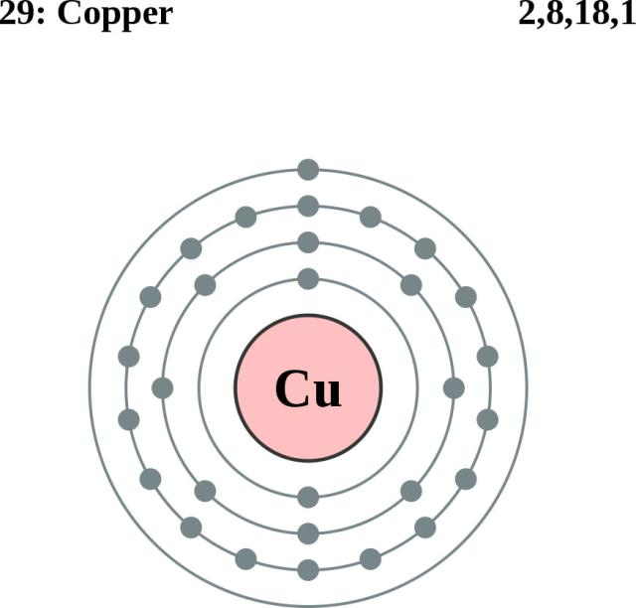

Slide 4
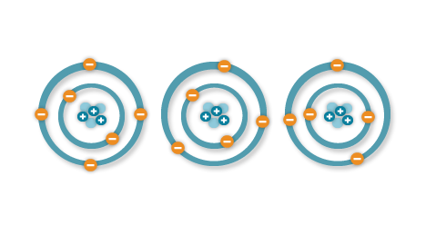
When electrons are "lost" from an atom, the free movement of these electrons constitutes an electric current.

Slide 5
Types of Electricity
Static
DC Current
AC Current

Slide 6
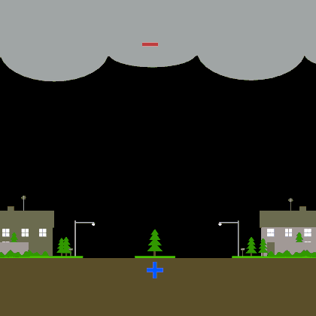
Static Electricity
Lightning

Slide 7
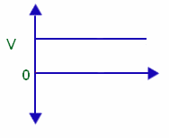
DC Electricity
Batteries

Slide 8
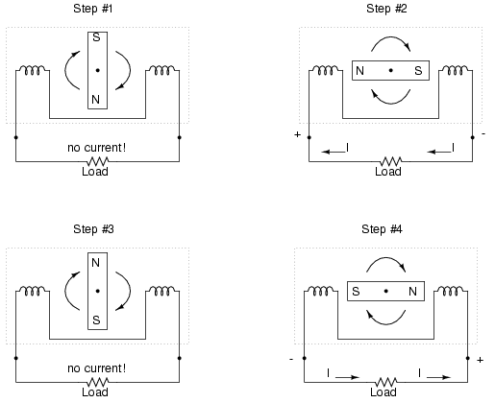
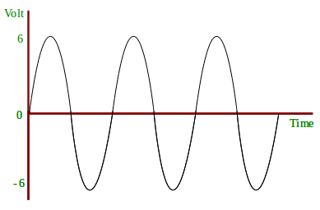
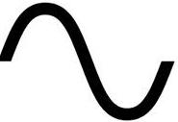
AC Electricity
Line voltage

Slide 9
Voltage
Discovered by an Italian Physicist Count Alessandro Giuseppe Antonio Anastasio Volta
Voltage is the “potential” of power, although referred to as pressure, it is not.
The higher the voltage potential, the easier electrons can flow threw the wire.
Symbol = V or E

Slide 10
Current or Amperage
Discovered by André-Marie Ampère, A French physicist and mathematician who is generally regarded as one of the main founders of the science of classical electromagnetism, which he referred to as "electrodynamics".
Current is the movement of electrons though wires and other conductive material
Similar to the flow of water through a pipe – more specifically, the amount of water through a pipe.
Symbol = I

Slide 11
Key names to look up for more information:
Alessandro Volta
André-Marie Ampère
Michael Faraday
Alexander Graham Bell
Thomas Edison
Nikola Tesla
George Westinghouse

Slide 12
Basic Safety
AC can KILL you!
Always be sure power is OFF when working on AC devices.
Never stand in water while working on AC devices.
More die from 120v than 240v
DC can hurt too!
Remove Jewelry when working with high current DC.
Water can increase conductivity.

Slide 13
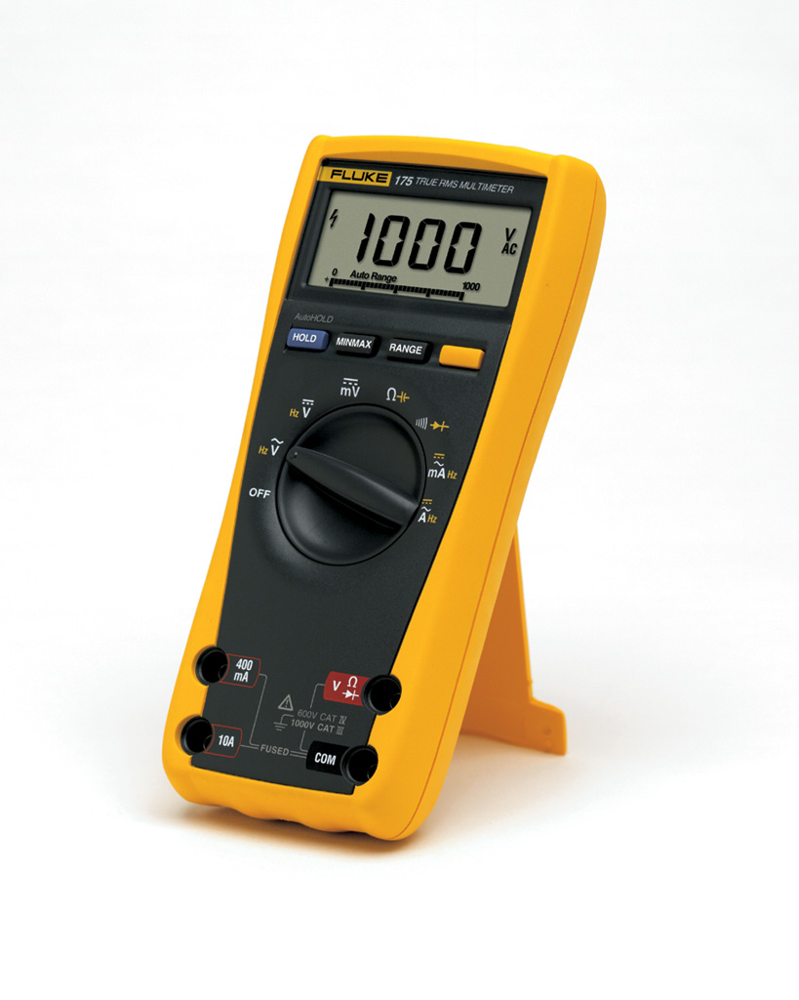
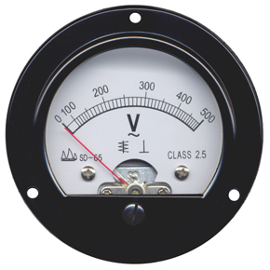
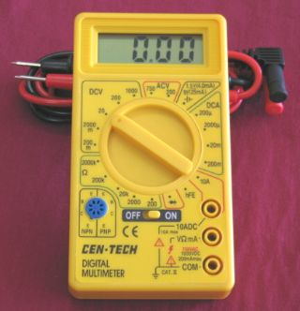
Reading a Meter

Slide 14
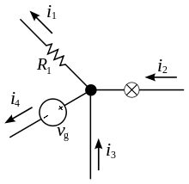
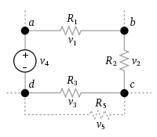
Kirchhoff’s Circuit Law
Gustav Robert Kirchhoff was a German physicist who contributed to the fundamental understanding of electrical circuits, spectroscopy, and the emission of black-body radiation by heated objects.
Kirchhoff’s Current Law (Kirchhoff’s First Law)
At any junction in an electrical circuit, the sum of currents flowing into that node is equal to the sum of currents flowing out of that node
Kirchhoff’s Voltage Law (Kirchhoff’s Second Law)
The directed sum of the voltage around any closed network is zero

Slide 15
OHM’s Law
Named after German physicist Georg Simon Ohm.
Ohm's law states that the current through a conductor between two points is directly proportional to the potential difference across the two points.
E = I x R
I = E/R
R = E/I

Slide 16
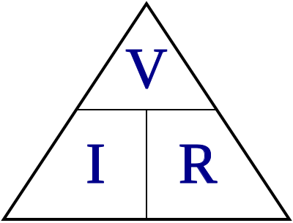
OHM’s Law Simplified

Slide 18
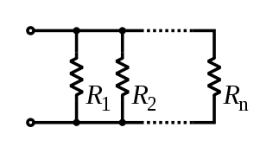
What is Resistance?
Electrical resistance, a measure of the degree to which a conductor opposes an electric current through that conductor.
Symbol R
Rules:
1. Resistance in Series Add together
R1+R2+R3…. = Total Resistance in a circuit.
2. Resistance in Parallel add the reciprocals of the resistances of each component and take the reciprocal of the sum. Total resistance will always be less than the value of the smallest resistance.
1/R1+1/R2+1/R3… = 1/Rt = Total Resistance in a circuit.

Slide 19
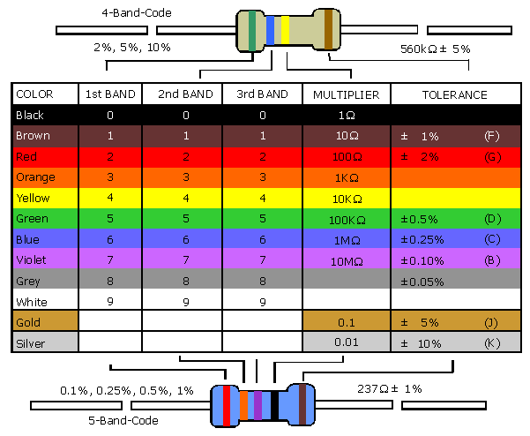

Slide 20
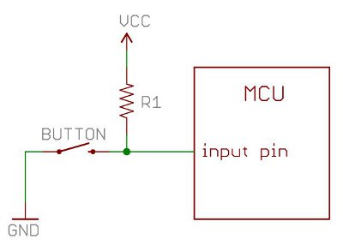
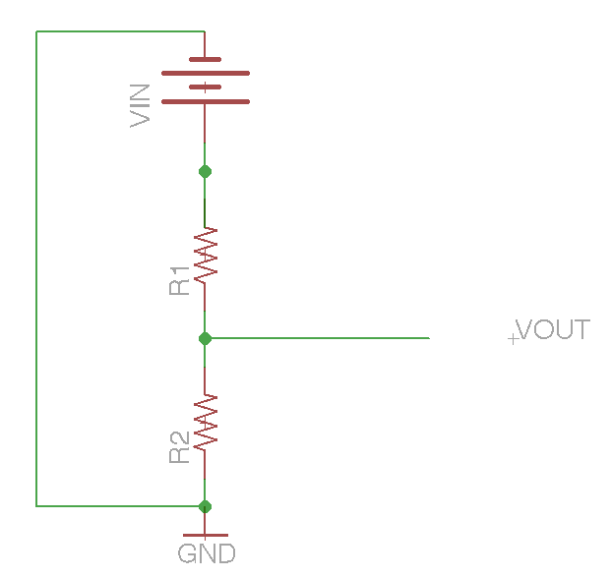
Primary Uses for resistors.
Pull Up / Down
Current Limiting
Voltage division
Other uses include Timing and filtering Circuits

Slide 21
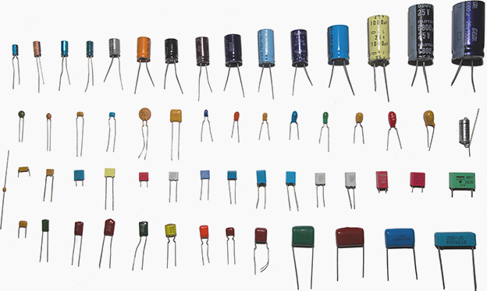
Capacitors
A capacitor (originally known as a condenser) is a electrical component used to store energy electro-statically in an electric field.
Capacitance is expressed as the ratio of the electric charge on each conductor to the potential difference (V) between them.
The unit of capacitance is the farad (F), which is equal to one coulomb per volt (1 C/V). Typical capacitance values range from about 1 pF (10⁻¹² F) to about 1 mF (10⁻³ F).
It is named after the English physicist Michael Faraday.
Some Types of Capacitors
Ceramic
Electrolyte
Tantalum
Plastic
Sliver mica

Slide 22
Uses for Capacitors.
Capacitors are widely used in electronic circuits for blocking direct current while
allowing alternating current to pass.
Some typical uses include Noise filters, Charge pumps, Timing Circuits
Capacitors in the series the total voltage difference from end to end is apportioned to each capacitor according to the inverse of its capacitance. The entire series acts as a capacitor smaller than any of its components.
Capacitors in a parallel configuration each have the same applied voltage. Their capacitances add up.
Parallel Capacitors
Ct = C1 + C2 + Cn
Capacitors in Series
1/Ct = (1/C1) + (1/C2) + (1/Cn)

Slide 23
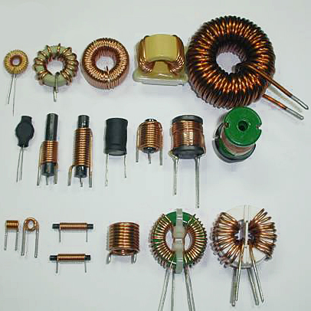
Inductors
Inductors are widely used in Analog circuits, filters, and most notably in power supply circuits and motors.
Types of Inductors
Air Core (coils)
Ferrite Core
Laminated (transformers)
Toroid
Sliver mica
Each type has it’s own advantage
and disadvantage – depending on use.

Slide 24
Inductors
The current through inductors in series stays the same, but the voltage across each inductor can be different. The sum of the potential differences (voltage) is equal to the total voltage.
Inductors in a parallel configuration each have the same potential difference (voltage).
Inductors in Parallel
1/Lt = (1/L1) + (1/L2) + (1/Ln)
Series Inductors
Lt = L1 + L2 + Ln

